Slide 1

` | Pimpri Chinchwad Education Trust’s Pimpri Chinchwad College of Engineering
 | Department of Computer Engineering Academic Year: 2020-2021 Semester: I
TITLE : BANK CUSTOMERS EXIT PREDICTIVE MODEL
Group Members: Guided By -
Varun Gadde - BECOB203 Prof. Priya Surana
Vedant Upganlawar - BECOB270

Slide 2
Introduction
A bank is investigating a very high rate of customers leaving the bank.
Investigate and predict which of the customers are more likely to leave the bank soon.
This project focuses on applying suitable data preprocessing steps such as handling of null values, data reduction, discretization of the 'Churn_Modelling.csv' dataset having 10,000 records of customers of a bank.

Slide 3
Requirements
Numpy - for Linear Algebra
Pandas - for Data Preprocessing and CSV I/O
Matplotlib - Data Visualization
sklearn.model selection - for Modelling
sklearn.linear_model - for Logistic Regression Classifier
sklearn.svm - for Support Vector Classifier
sklearn.naive_bayes - for Gaussian Naive Bayes Classifier
sklearn.neighbors - for KNeighbors Classifier
sklearn.ensemble - for Random Forest Classifier
sklearn.metrics - for Accuracy Score, Confusion Matrix and Classification Report

Slide 4
Algorithms implemented
Random Forest Classifier
Logistic Regression
Naïve Bayes Classifiers
K-Nearest Neighbor
Support Vector Machines

Slide 5
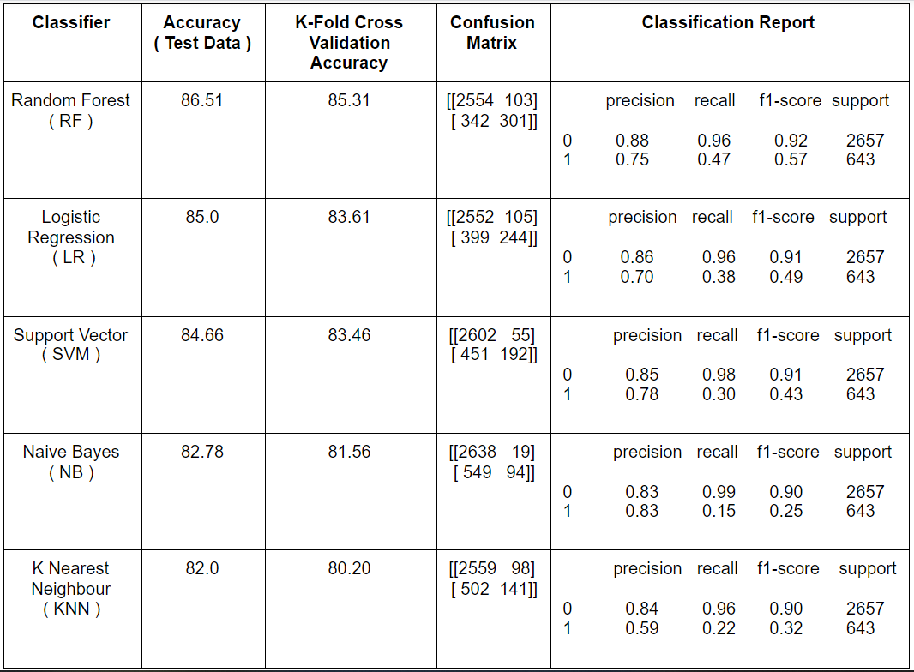
Metrics and Comparison

